Slide 1

Targeting Immune Checkpoint Therapy Resistance with Novel MSC-Engineered Extracellular Vesicles
Yves Greatti
April 29, 2024
Notes:
Today present my project which consists in designing a novel drug using Mesenchymal Stem Cell-derived Extracellular Vesicles or EVs.

Slide 2
Significance

Slide 3
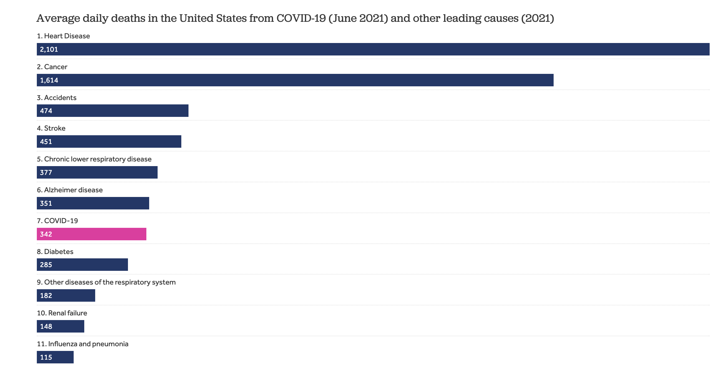
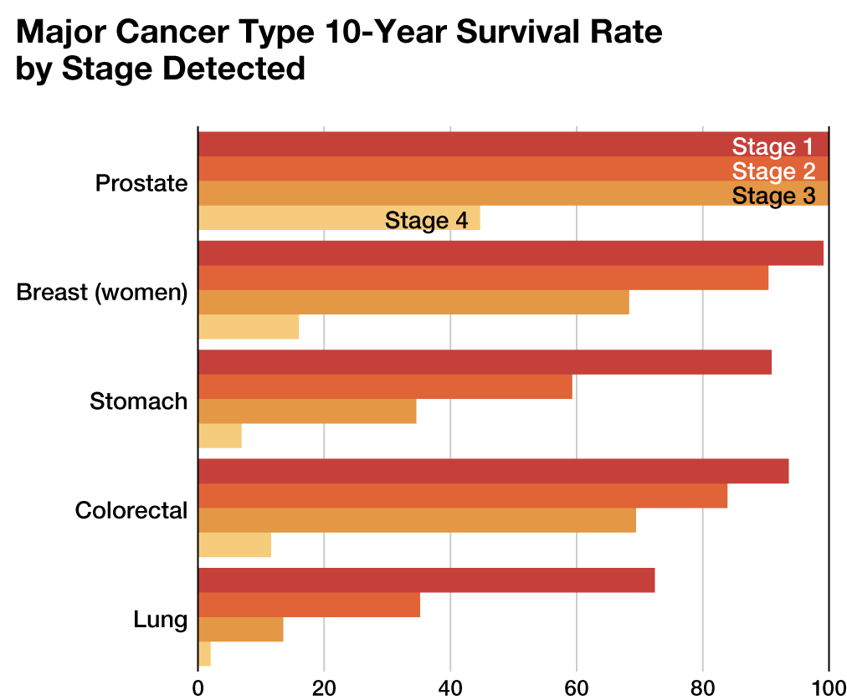
The Persistent Challenge of Cancer Today
Notes:
Economic and health impacts of cancer.

Slide 4
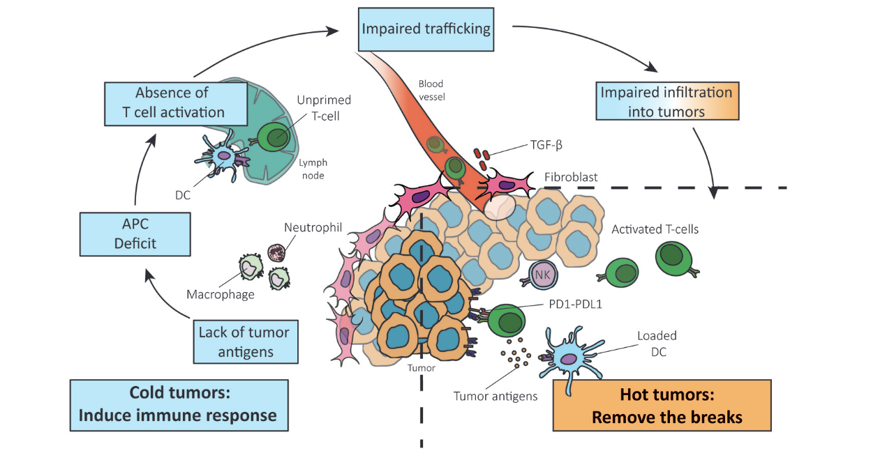
Reversing Cold Tumor Into a Hot Tumor
Notes:
Challenges posed by cold tumors in cancer treatment.
Importance of transforming cold tumors to hot tumors to enhance the efficacy of immunotherapies.

Slide 5
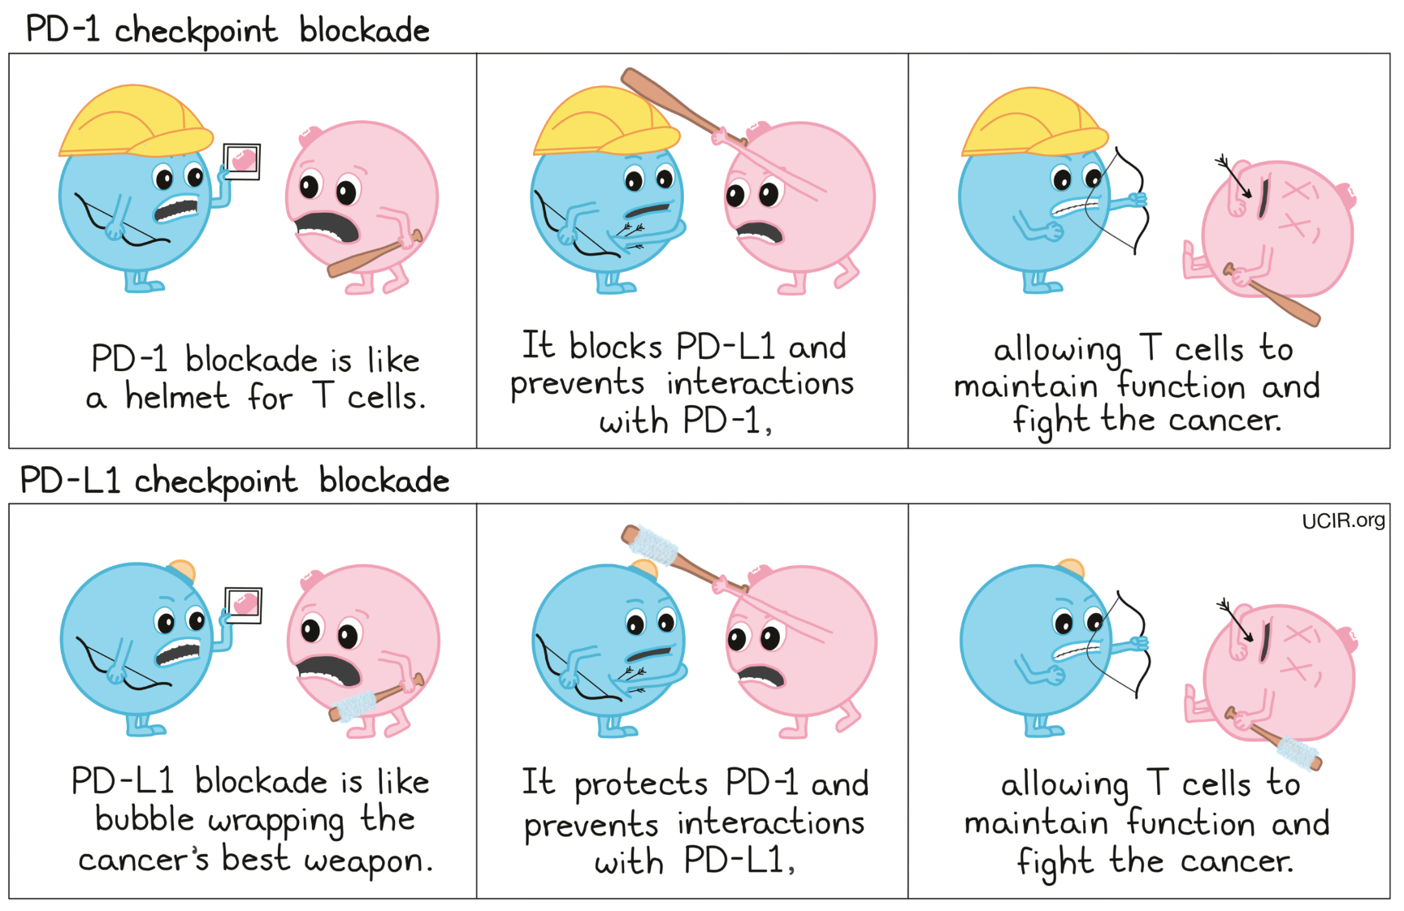
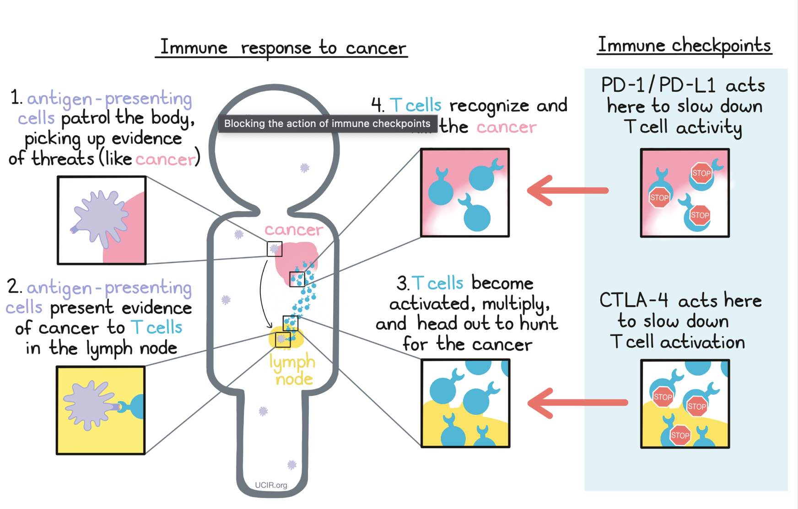
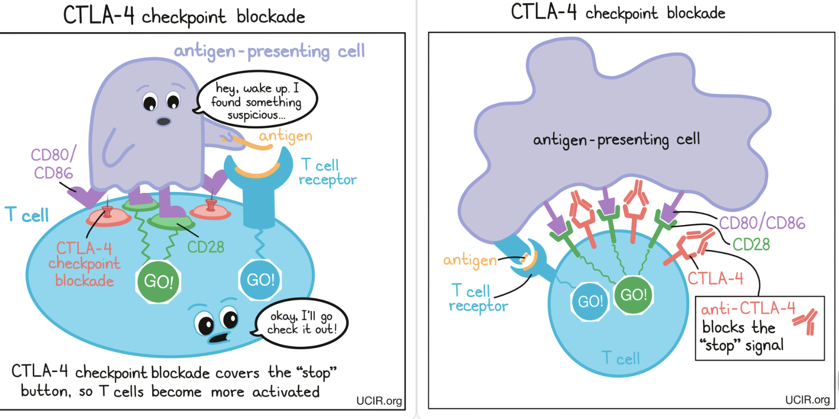
Immune Checkpoint Blockade Therapy
Notes:
Advances in immune checkpoint inhibitors (ICIs) and their limitations in cold tumors.

Slide 6
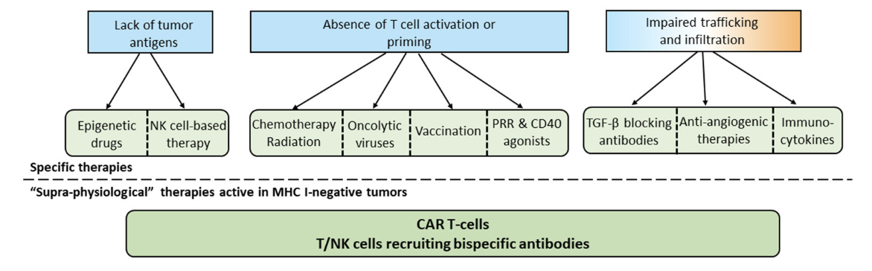
Common Approaches to Overcome Absence of T cells
Notes:
current landscape of strategies for warming up cold tumors.

Slide 7
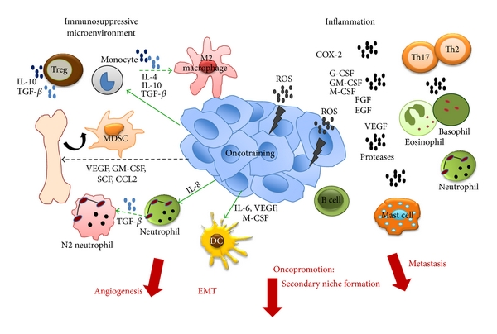
Pro-tumoral activities of the Immune System
Notes:
Dual role of immune cells in TME; show immunosupression here (positive)
includes immune cells, signaling molecules, ECM and so on. Immune cells play a critical role in the tumor microenvironment, influencing the development, progression, and metastasis of tumors through the combined action of many cytokines
The fact that immune cells can behave as guardians (anti-tumour immunity) or as bystanders or supporters of the tumour (pro-tumour immunity) makes them a “double-edged sword” in the TME.

Slide 8
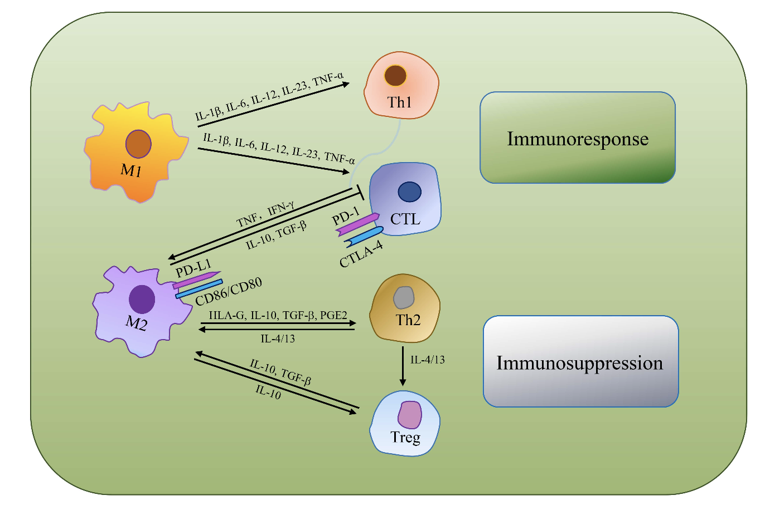
Tumor Associated Macrophages (TAMs)
TAMs as the most dominant immune cell type, are an indispensable target for immunologically cold tumor
Notes:
Role of Tumor-associated macrophages (TAMs) and other immune cells in cold tumors.
TAMs play a significant role in cancer biology, including influencing tumor growth, angiogenesis, metastasis, and the suppression of antitumor immunity.
Their abundance and multifunctional roles make them key players in tumor ecology and an important focus in cancer research and therapeutic development.

Slide 9
Innovation

Slide 10
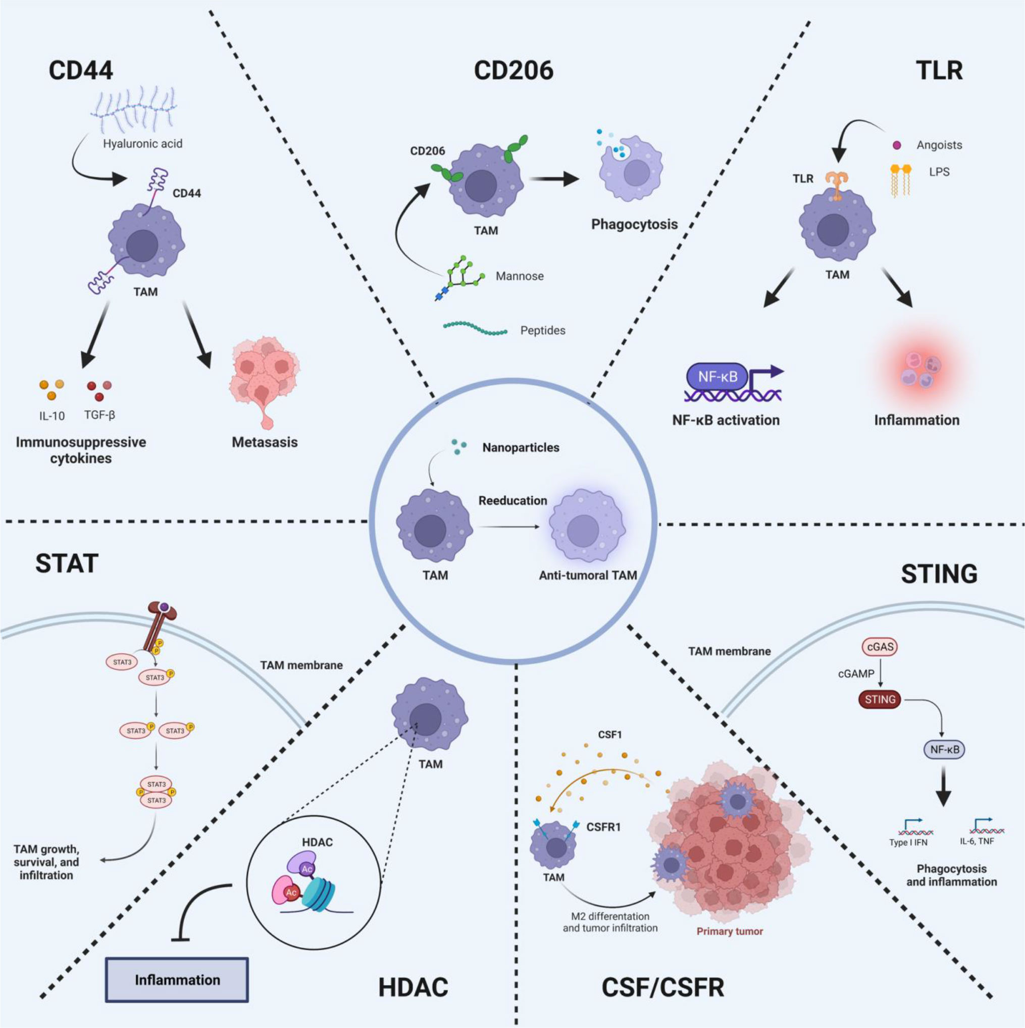
Strategies to reeducate TAMs
Notes:
TLRs are a class of pattern recognition receptors that can detect the substances derived from invading pathogens, which
play essential roles in innate immunity and inflammatory responses.
Colony Stimulating Factor-1(CSF-1), also recognized as colony-stimulating factor (M-CSF), is a cytokine considered a major growth factor regulating the production, differentiation
and function of TAM. CSF-1 is associated with tumor progression, metastasis, angiogenesis, and treatment resistance.
CD44 is a transmembrane adhesion glycoprotein. Aberrant upregulation of CD44 in tumor cells is closely related to tumor immune escape and invasion.
CD206 is a membrane-bound protein c
The JAK-STAT pathway is an inflammatory signaling pathway. STAT signaling is important for macrophage polarization,
while IFN-g signaling inducing phosphorylation of downstream STAT1, which in turn activate STAT1.

Slide 11
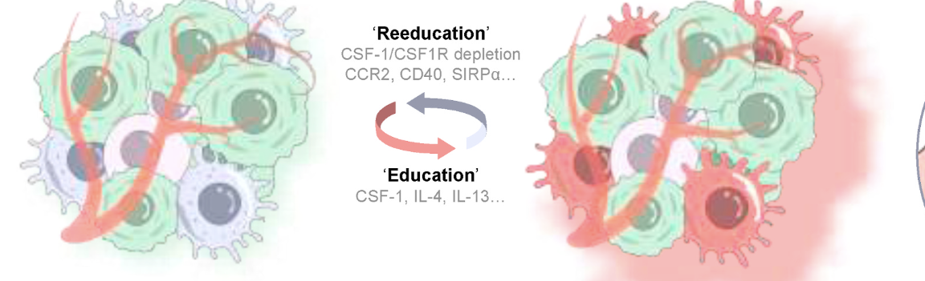
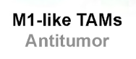
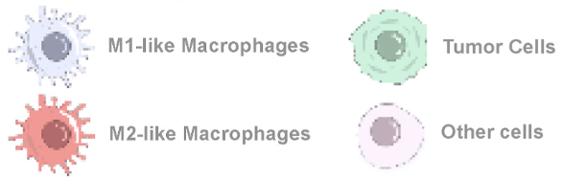
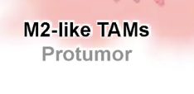
CSF-1/CSF1R Inhibitors modify TAMs behavior within the TME
Notes:
Strategic use of CSF-1R inhibitors to modify the behavior of TAMs within the tumor microenvironment.
M1-like macrophages characterized by biomarkers of CCR7, CD40, CD11c, and M2-like
macrophages by markers of CD169, CD206.
M1-like and M2-like TAMs are interconversionable under stimulation of various cytokines and chemokines termed
‘education’ factors and ‘reeducation’ factors.
M2-like TAMs secrete tumorigenic cytokines, like CCL2, IL-6, IL-10, to promote tumor cell growth.
TAMs express a variety of transmembrane proteins in
response to ‘education’ factors, including CSF1R, CCR2, CD40, SIRP1α.

Slide 12
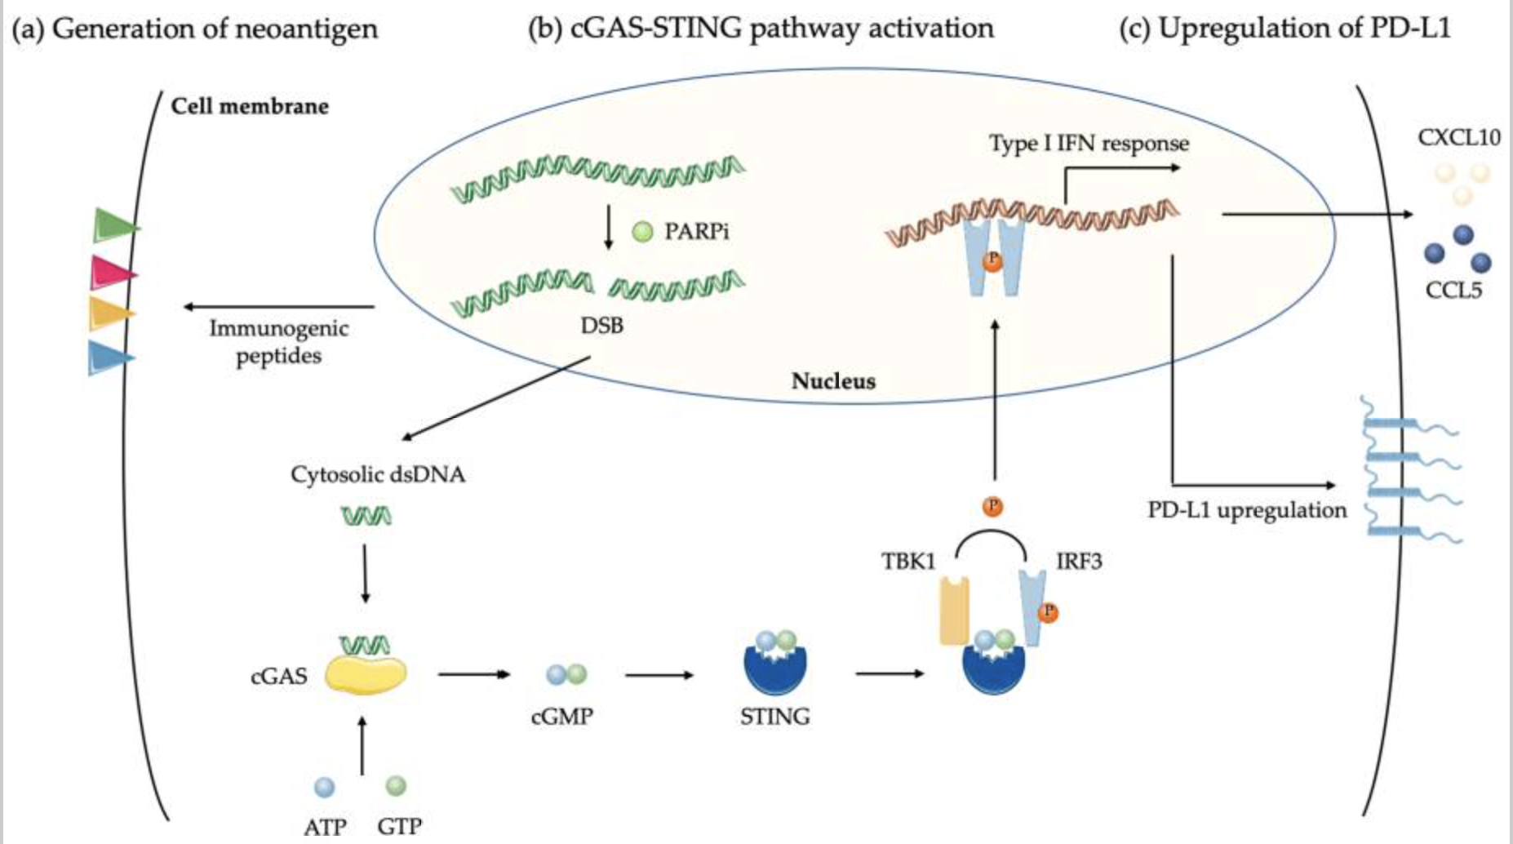
Biological effects of PARP Inhibitor on Cancer Cells
Notes:
PARPi delays DNA repair that generates double-strand breaks (DSB) and catastrophic unrepaired DNA damages in tumor cells, increasing neoantigens load and tumor mutation burden;
DSB induced by PARPi in tumor cells produce double-strand DNA (dsDNA) fragments that, through cyclic GMP-AMP synthase (cGAS) binding
lead to stimulator or interferon genes (STING) activation and the generation of a type interferon (IFN) response. This upregulates chemokines CCL5 and CXCL10 leading to T cell recruitment
(c) Upregulation of PD-L1 via STING pathway led to T cell exhaustion.

Slide 13
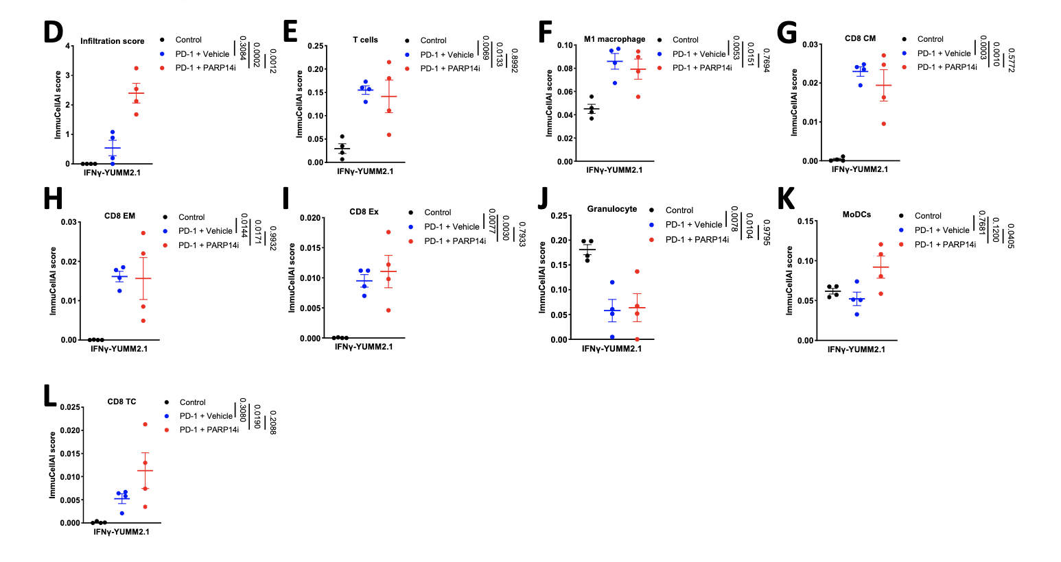
PARP14i Reverses Acquired Resistance to PD-1 Therapy
Effector T cell infiltration is
enhanced in tumors derived from cells pre-treated with IFNγ in immuno-
competent female mice when PARP14 is pharmacologically inhibited or
knocked down, while the presence of regulatory T cells is decreased, leading to
restoration of α-PD-1 sensitivity
C. W. Wong et al., “PARP14 inhibition restores PD-1 immune checkpoint inhibitor response following IFNγ-driven acquired resistance in preclinical cancer models,” Nat. Commun., vol. 14, no. 1, p. 5983, 2023, doi: 10.1038/s41467-023-41737-1
Notes:
D: infiltration, E: T cell, F: M1 macrophage,
G: CD8 central memory (CM) T cells, H: CD8 effector memory (EM) T cells,
I: exhausted (Ex) CD8 T cells, J: Granulocytes, K: Myeloid Dendritic cell (MoDC),
L: CD8 cytotoxic T cell (Tc).

Slide 14
Research Strategy

Slide 15
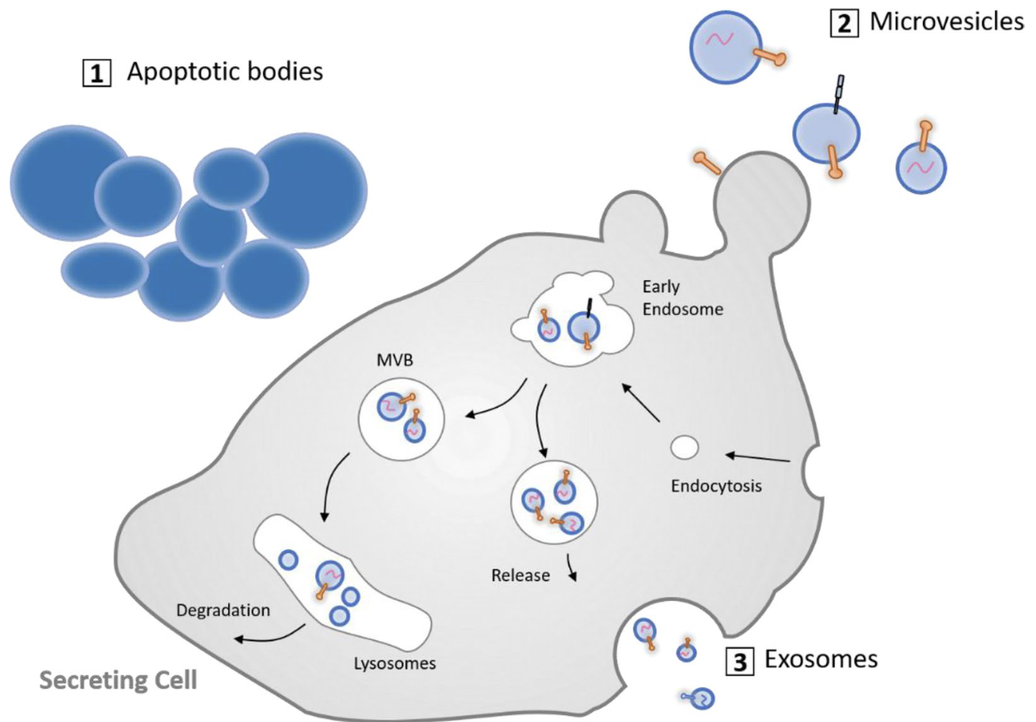
Therapeutic Potential of Mesenchymal Stem Cell-Derived Extracellular Vesicles
MSCs are favored as sources of EVs due to:
Ability to modulate the immune response
Promote tissue repair and regeneration
Low immunogenicity
Engineering flexibility
Scalable production
Notes:
Exosomes
Size: Typically 30-100 nm in diameter.
Features: Exosomes are rich in nucleic acids, proteins, and lipids. They naturally encapsulate these molecules, making them excellent carriers for small molecule drugs, RNA, or other therapeutic agents.
Usage: Due to their small size and composition, exosomes can cross biological barriers such as the blood-brain barrier, making them ideal for targeting drugs to specific sites, including the brain.
Microvesicles
Size: Typically larger than exosomes, ranging from 100 to 1000 nm in diameter.
Features: Microvesicles carry a variety of biomolecules, including proteins and lipids, and also encapsulate nucleic acids and cytosolic components.

Slide 16
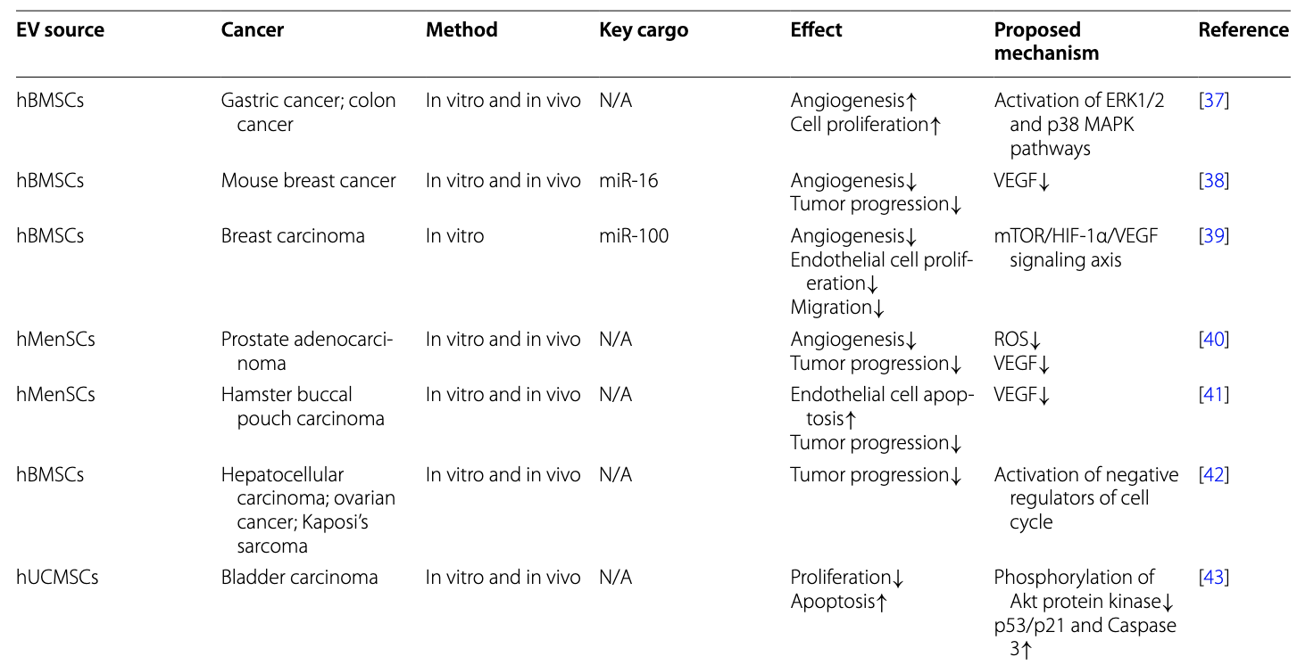
Effects of MSC-derived EVs on Different Types of Cancers
iPSC-MSC-EV Advantages
Anti-Inflammatory Bioactivity
Scalability
Donor Availability
Could induce M2-like transition
Z. Weng et al., “Therapeutic roles of mesenchymal stem cell-derived extracellular vesicles in cancer,” J. Hematol. Oncol., vol. 14, no. 1, p. 136, 2021, doi: 10.1186/s13045-021-01141-y

Slide 17
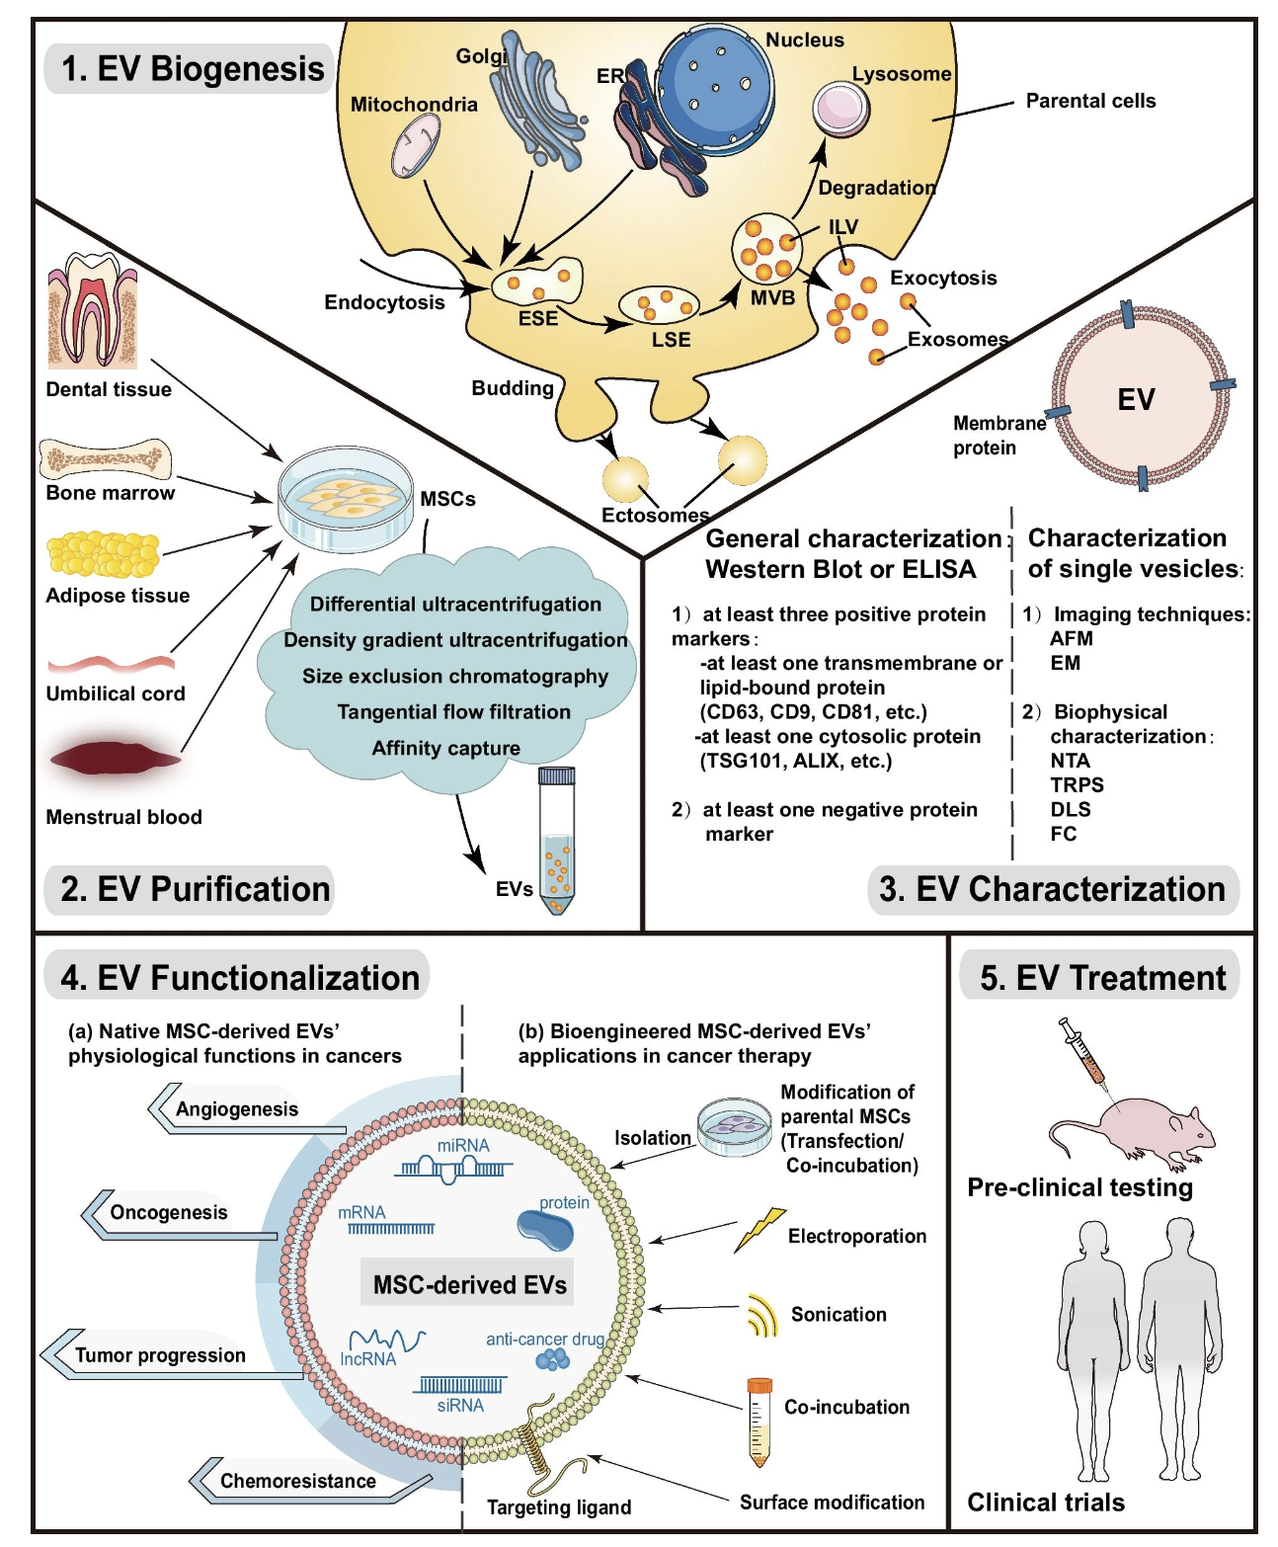
Key steps in the process of Engineering MSC-derived EVs’ Therapeutic Applications
There are well-established and reliable methods for engineering MSC-derived EVs

Slide 18
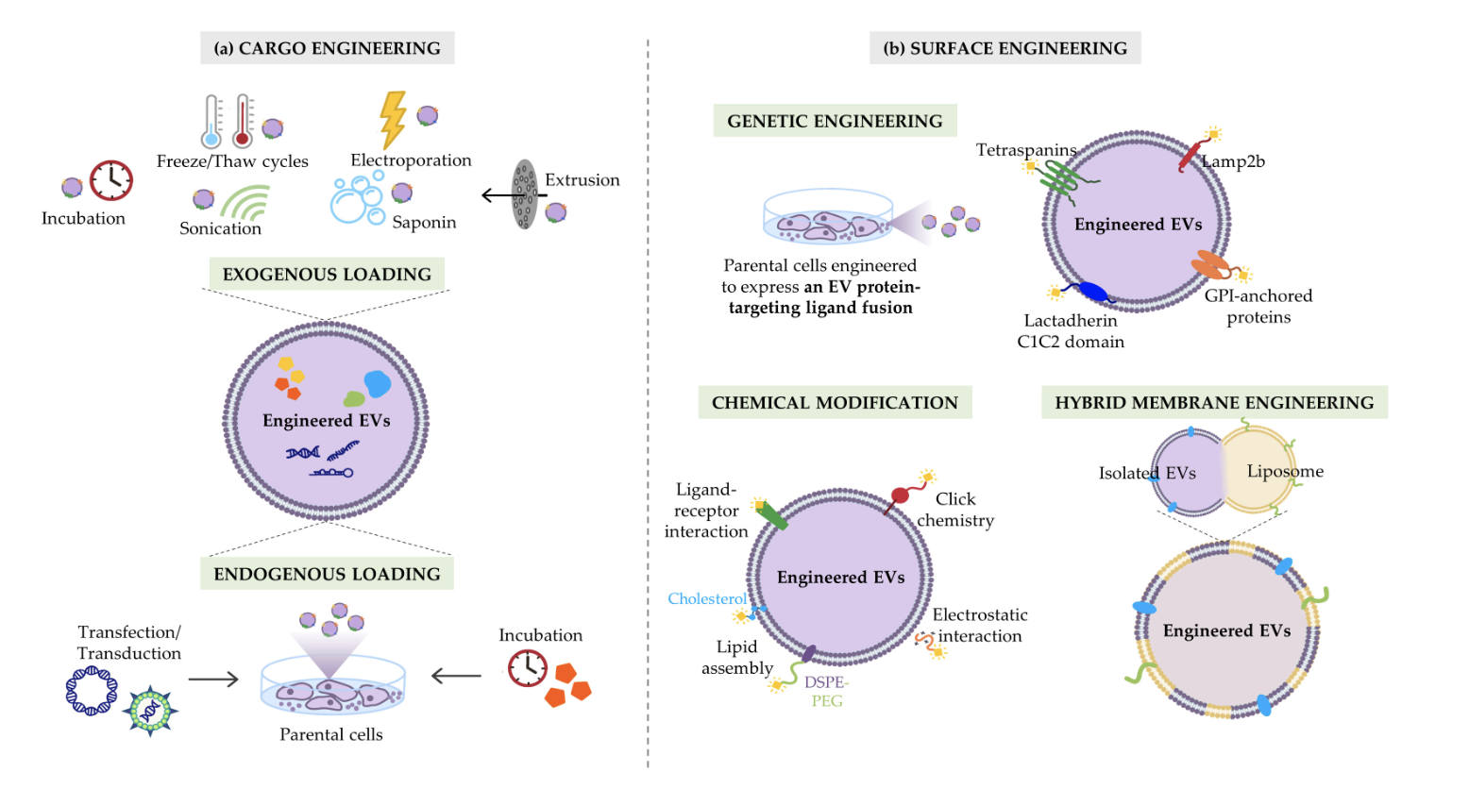
Strategies to maximize the therapeutic efficacy of EVs
Click Chemistry: Ideal for attaching small molecules to exosomes due to its high specificity and yield.
Lipid Anchoring: Small molecule agonists or inhibitors can be modified to include lipid tails, facilitating their integration into the exosome lipid bilayer.
Nanocarrier Encapsulation: Encapsulate the drug within exosomes to protect the active agents from degradation and ensure targeted delivery.

Slide 19
Methodology for the design of the MSC-derived EV Therapeutic Agent
1. Enrich the M1 population of tumor-associated macrophages (TAMs) and modulate TAM recruitment and distribution.
Approach: Utilize chemical conjugation techniques to attach R848 to the exosome surface.
2. Create dual-targeting exosomes that selectively target TAMs while evading the immune system via CD47 expression, which signals "don't eat me" to phagocytes.
Approach: Combine CD47 Expression with TAM-Specific Ligands.
Introduce vectors encoding CD47 into cell cultures that will be used to harvest exosomes. Use covalent attachment to attach antibodies against M2-like TAM marker CD80 to the exosome surface.
3. Ensure that exosomes are sufficiently expressing CD47 to avoid uptake macrophages and dendritic cells of the MPS without impairing the ability to target specific cells at the tumor site.
Approach: optimize the level of CD47 expression on exosomes using a promoter with adjustable strength to find the right balance where exosomes can evade phagocytosis without completely inhibiting macrophage interaction where needed.
4. Modify the R848 molecule for pH-sensitive release near the cancer cells.
Approach: Synthesize a peptide linker that is sensitive to the acidic pH typical of tumor environments. This peptide should include a sequence specific to the matrix metalloproteinase-2 (MMP-2), which is often overexpressed in tumor tissues.
Notes:
The peptide linker will be synthesized such that one end has a functional for attachment to R848, and the other end can be conjugated to the exosome surface or another suitable carrier.
Integrate a sequence that is specifically recognized and cleaved by MMP-2. MMP-2 recognizes and cleaves peptides containing a specific sequence of amino acids. For example, a commonly used sequence for MMP-2 sensitivity is 'GPLGVRG’.
Once the peptide-linked R848 is localized near the tumor cells (where MMP-2 expression is high), MMP-2 enzymes will cleave the peptide at the specific recognition site ('GPLGVRG’).
This cleavage releases R848 in an active form precisely at the site where MMP-2 is overexpressed.

Slide 20
Testing and Validation

Slide 21
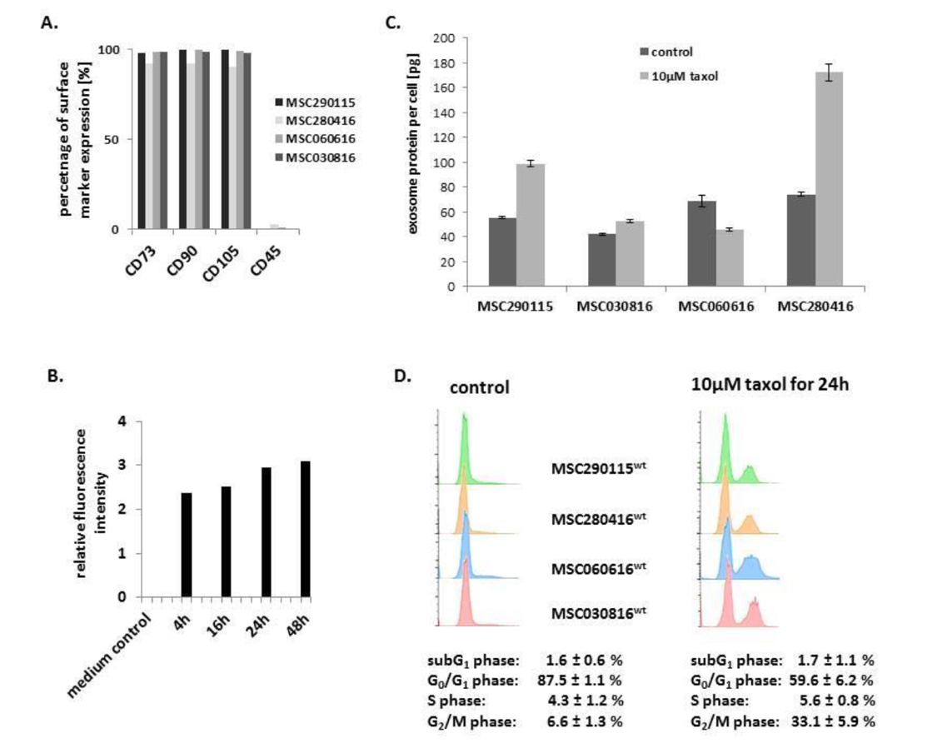
Assessment of Cytotoxic Effects of Engineered Exosomes Produced by MSCs
A) Characterization of four different MSC investigated populations.
B) Kinetic of exosomes production by MSC^{GFP}: progressive exosome release increase to reach a plateau after 24h.
C) Quantification of exosome produced per cell within a specific timeframe.
D) Apoptotic/necroptotic subG1 phase cells should remain at equally low levels in control and drug treated MSC populations: confirming no detectable cytotoxic effects.
Notes:
\

Slide 22
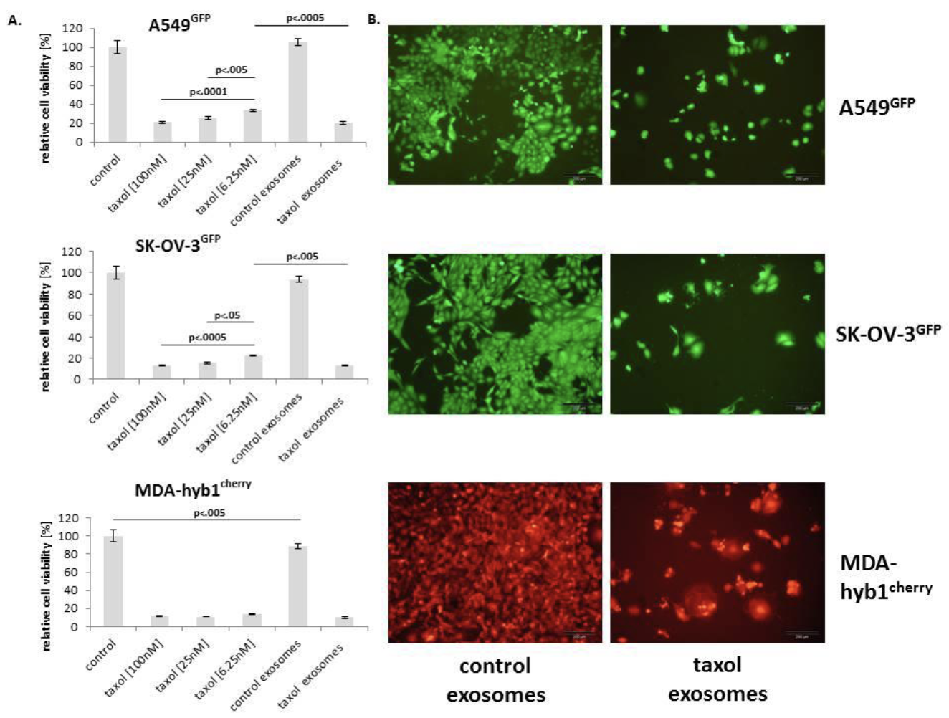
Therapeutic Response Assessment of Engineered Exosomes on a Panel of Cancer Cell Lines In Vitro
Relative chemotherapeutic response of different human cancer cell populations, including:
A549GFP lung cancer (upper panel),
SK-OV-3GFP ovarian cancer (middle panel),
MDA-hyb1cherry breast cancer (lower panel) cells
Notes:
\

Slide 23
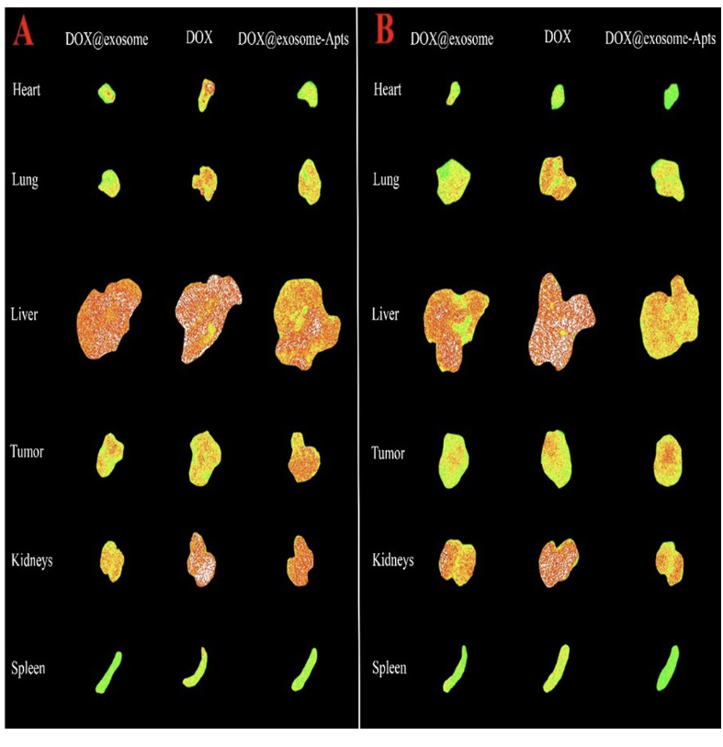
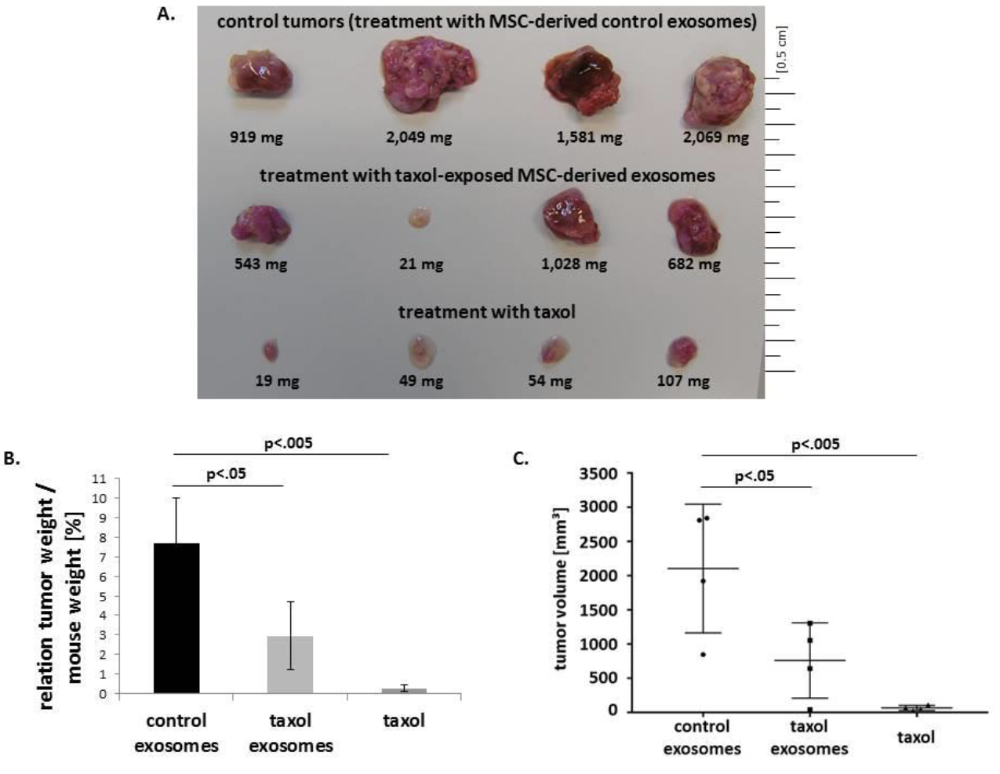
In Vivo Efficacy and Safety Evaluation
We anticipate a reduction in tumor volume and in metastasis when administering R848-loaded exosomes, at dosages lower than those used for free R848 injections
Fluorescence images of tumor, liver, spleen, kidneys, heart, and lungs of
tumor-bearing mouse models after 6h and 24h post injection
Notes:
\

Slide 24
References
“2024-cancer-facts-and-figures-acs.pdf”.
X.-F. Yi et al., “Dual antitumor immunomodulatory effects of PARP inhibitor on the tumor microenvironment: A counterbalance between anti-tumor and pro-tumor,” Biomed. Pharmacother., vol. 163, p. 114770, 2023, doi: 10.1016/j.biopha.2023.114770
Turning cold tumors into hot tumors by improving T cell infiltration
Yuan-Tong Liu, Zhi-Jun Sun doi: 10.7150/thno.58390
Turning cold tumors hot: from molecular mechanisms to clinical applications
Jiahui Zang et al. Trend in Immunology
Strategies for Heating Up Cold Tumors to Boost Immunotherapies
Danie Zabranksy et al. Annual Review of Cancer Biology with chemotherapies to improve patient outcomes. Hot and cold tumors: Immunological features and the therapeutic strategies
L Wang, H Geng, Y Liu, L Liu, Y Chen, F Wu, Z Liu- https://doi.org/10.1002/mco2.343
B. L. Russell, S. A. Sooklal, S. T. Malindisa, L. J. Daka, and M. Ntwasa,
“The Tumor Microenvironment Factors That Promote Resistance to Immune Checkpoint Blockade Therapy” Front. Oncol., vol. 11, p. 641428, 2021, doi: 10.3389/fonc.2021.641428
Combining in site vaccination and immunogenic apoptosis to treat cancer.
Arman Lamai, Mehdi Shalgolzari – Future Medecine – Immunotherapy – Vol.15, Issue 5
Dendritic cells and natural killer cells: The road to a successful oncolytic virotherapy
Matin Ghasemi et al. Frontiers in Immunology
Pouring Petrol on the flames: Using oncolytic virotherapies to enhance tumor immunogenicity.
Alicia Teijeira Crespo et al. Wiley Library, Immunology
Unlocking the potential of antibody-drug conjugates for cancer therapy
Joshua Z. Drago et al. doi:10.1038/s41571-021-00470-8.
Tumor Targeting of a Sting Antagonist with an Antibody-Drug Conjugate Elicits Potent Anti-Tumor Immune Responses.
Antibody-Drug Conjugates: A Review of Approved Drugs and Their Clinical Level of Evidence
Review by Pooja Gogi et al. Cancers
The Evolution of Antibody-Drug Conjugates: A Positive Inflexion Point
Anthony W. Tolcher - ASCO Educational Book
Igniting Hope for Tumor Immunotherapy: Promoting the “Hot and Cold” Tumor Transition
Chen Wei et al., DOI: 10.1177/11795549221120708
Sage Journal: Clinical Medicine Insights: Oncology Volume 16.
Advancing cellular immunotherapy with macrophages
Alok K. Mishra et al. DOI: https://doi.org/10.1016/j.lfs.2023.121857
Targeting tumor-associated macrophages in hepatocellular carcinoma: biology, strategy, and immunotherapy
Hongyu Zheng et al. Cell Death Discovery (2023(9: 65) Nature
Doi: https://doi.org/10.1038/s41420-023-01356-7
CSF1R inhibitors are emerging immunotherapeutic drugs for cancer treatment.
Jiachen Wen et al., DOI: 10.1016/j.ejmech.2022.114884
Elsevier - European Journal of Medicinal Chemistry
Targeting tumor-associated macrophages for successful immunotherapy of ovarian carcinoma
Iva Truxova et al., DOI: 10.1136/jitc-2022-005968
Journal for Immunotherapy 2023
Sophisticated genetically engineered macrophages, CAR-Macs, in hitting the bull’s eye for solid cancer immunotherapy.
Nese Unver, DOI: https://doi.org/10.1007/s10238-023-01106-0
Clinical and Experimental Medicine 2023
Engineering extracellular vesicles derived from macrophages for tumor therapy.
Ying Yan et al., DOI: 10.1039/D2MA00961G
Royal Society of Chemistry

